Slide 1

Life Expectancy
Irina Belaya
3 August 2022

Slide 2
Objectives
Primary objective:
What criteria determine life expectancy across countries?
Secondary objectives:
How does life expectancy compare between developed and developing countries?
What defines country status as “developed” / “developing”?

Slide 3
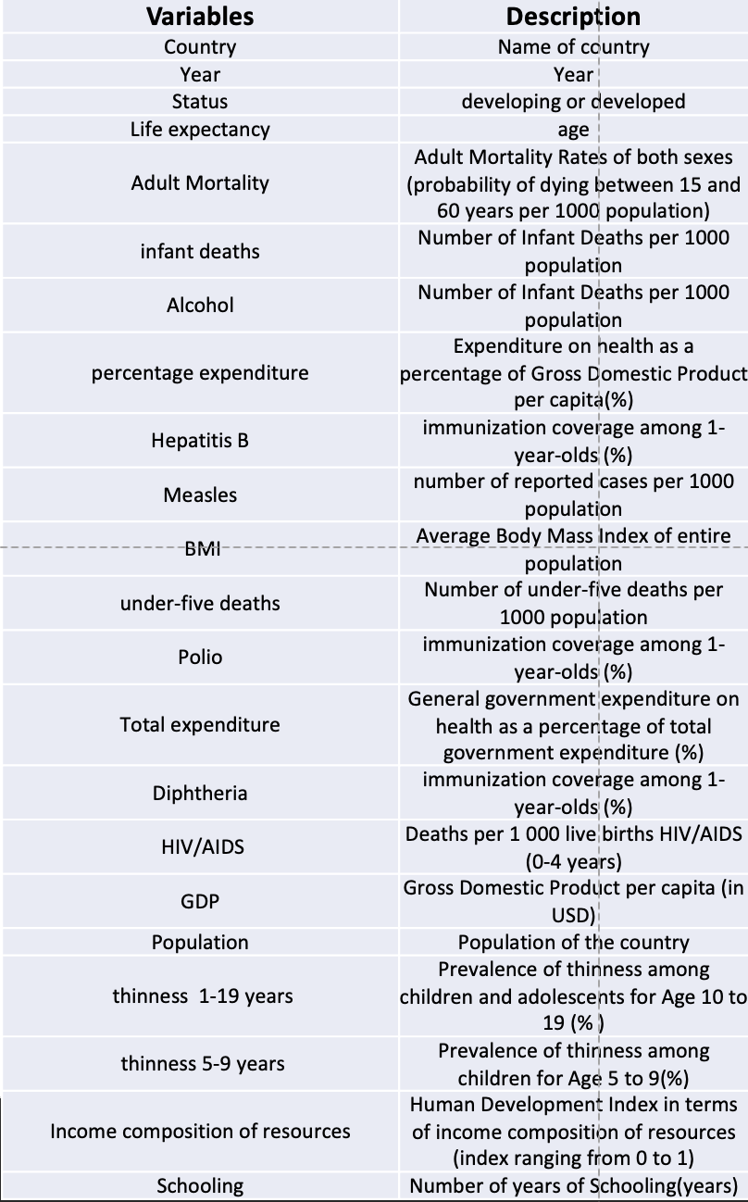
Data Preparation
The dataset is composed of 22 variables that may impact
life expectancy among 193 countries.
The target life_expectancy is a neumerical variable
There are no null values in categorical columns
The space in the countries name with space
Changed the column names i.e., Life expectancy to “life_expectancy”
The columns with too many null values
Using Z-score for outlier 122 and 24 outliers
Notes:
Possible questions to discuss here:
How good was the data quality?
What did you need to do to procure it?
What tools or code did you need to use to prepare it for analysis?
What challenges did you face?

Slide 4
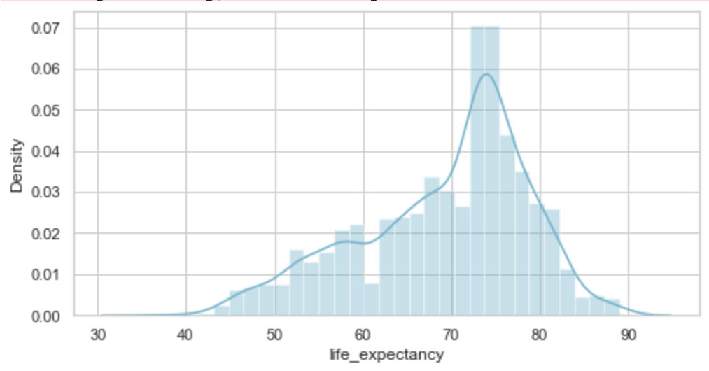
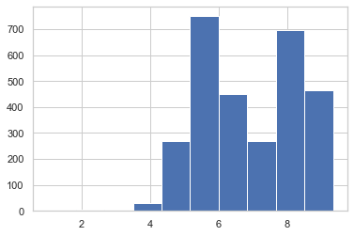
Data Analysis
The target is the life_expectancy column, which is skewed
Applied Square Root, Log and BoxCox transformation to see which technique will show a better result. The Square Root data transformation led to significant reduction in skewness from -0.9 to -0.1 for life expectancy.

Slide 5
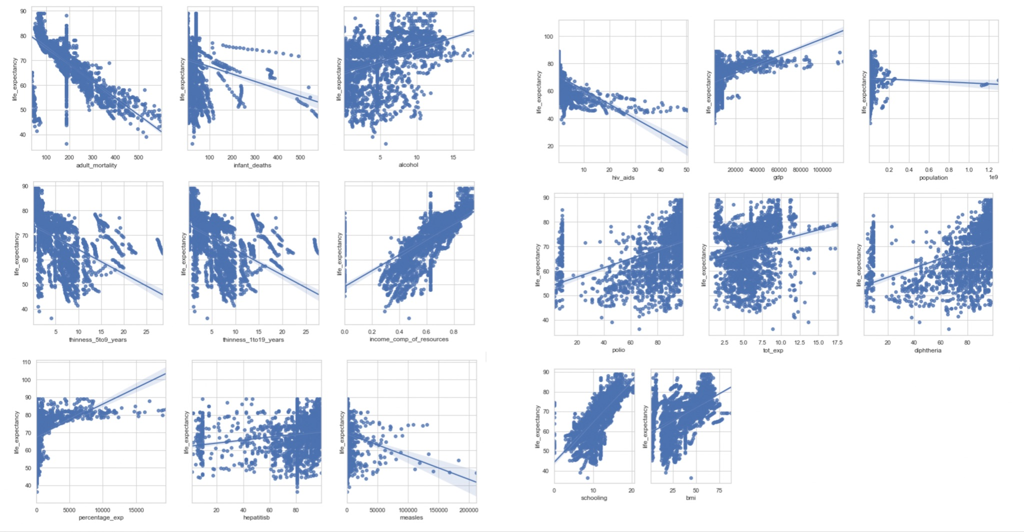
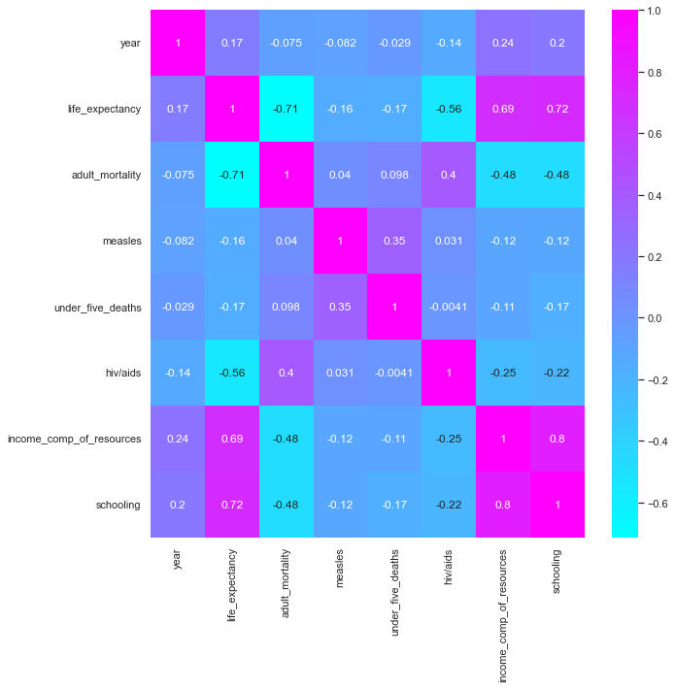
Data Analysis
Linear correlation graphs for the life expectancy in relation to each variable in the dataset and excluded
those with no linear relationship.
New dataset contains 9 independent variables:
'life_expectancy',
'adult_mortality',
'bmi',
'polio',
'diphtheria',
'hiv_aids',
'gdp',
'income_comp_of_resources',
'schooling'

Slide 6
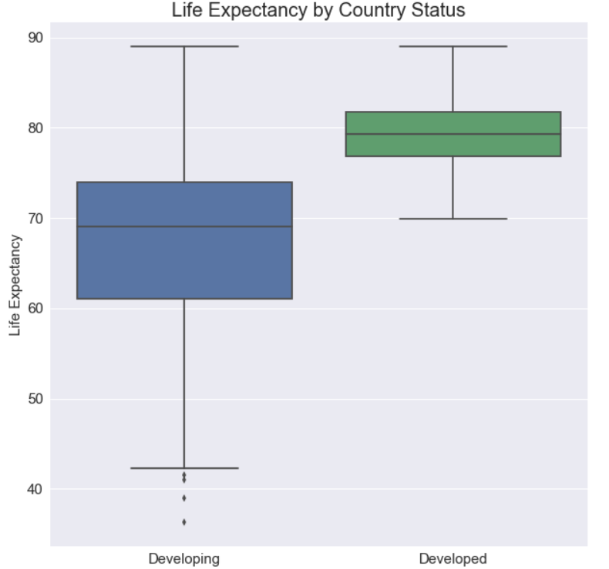
Life expectancy is significantly higher in developed vs. developing countries Paired t-test
*
Life expectancy between developing and developed countries (p<0.05).

Slide 7
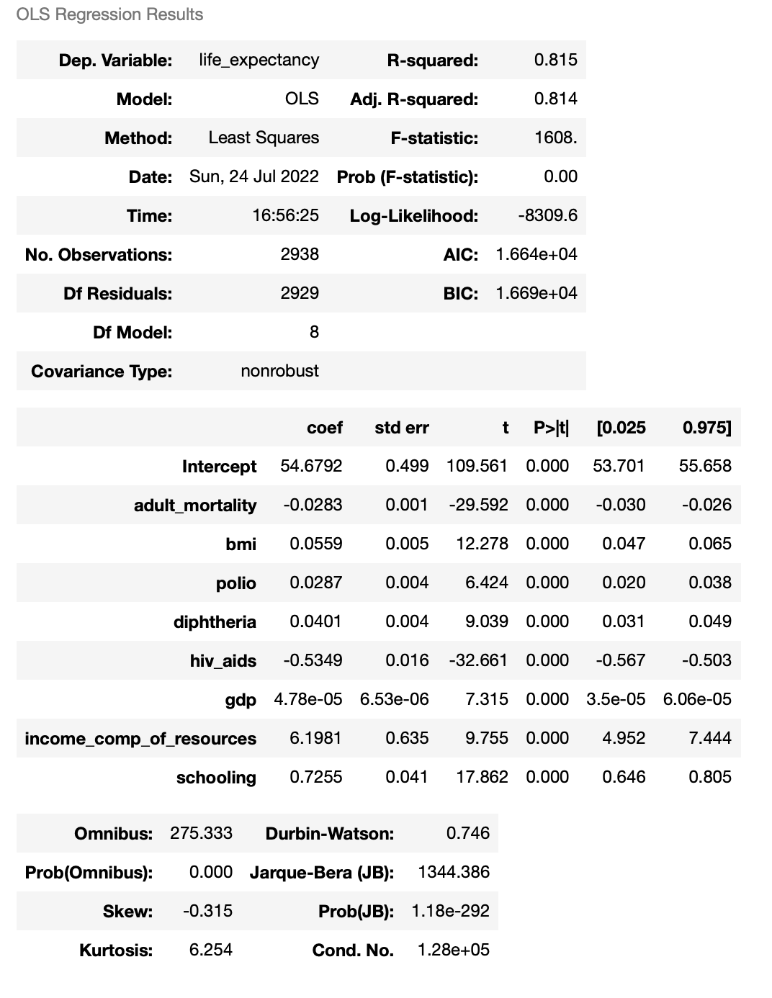
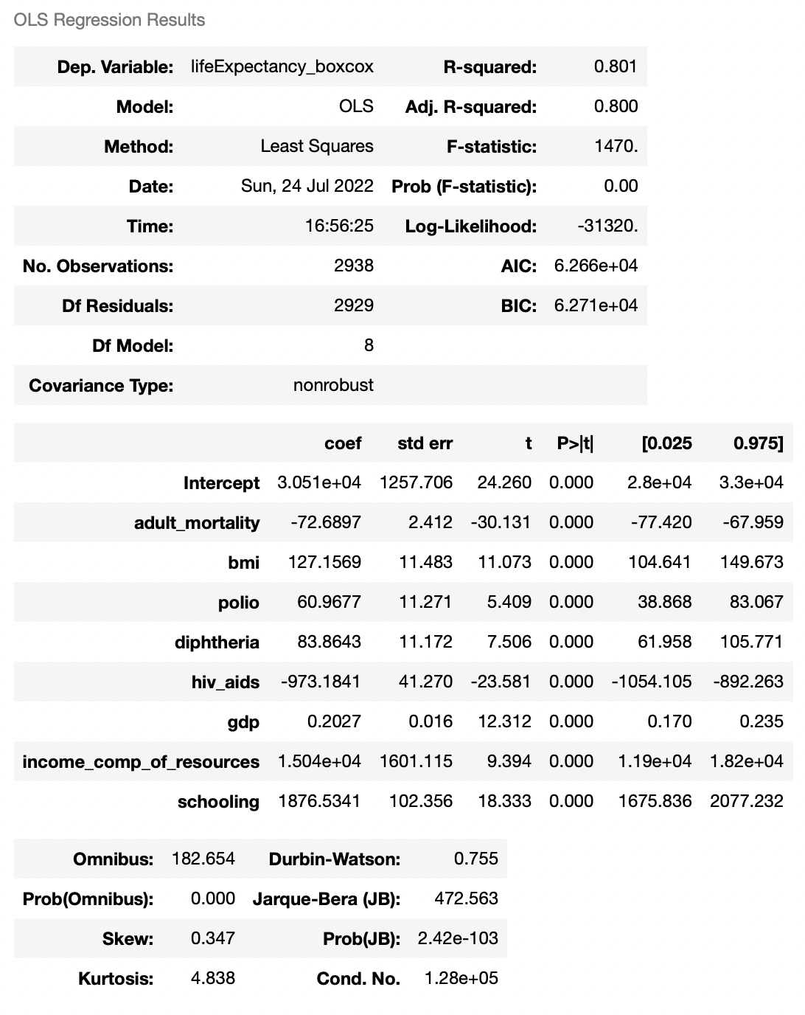
Model 1: Multi-linear regression
The multi-linear regression model with the target variable life_expectancy (no transformation) performed better with R-squared is 0.815 as opposed to 0.800 in the model with transformed dataset.
Notes:
Mention that in this part we use a predictive model.
Maybe in the beginning mention that we use a combination of inference and predictive models to address all outlined objectives
Related to this regression:
Description of summary and most important points like p-value and R-squared (R-squared is the accuracy of this model)
Description of what was done like testing with original life_expectancy and BoxCox transformed and that the original performed better.
Also, testing with all variables and with only some of them and that the model that included all variables performed better

Slide 8
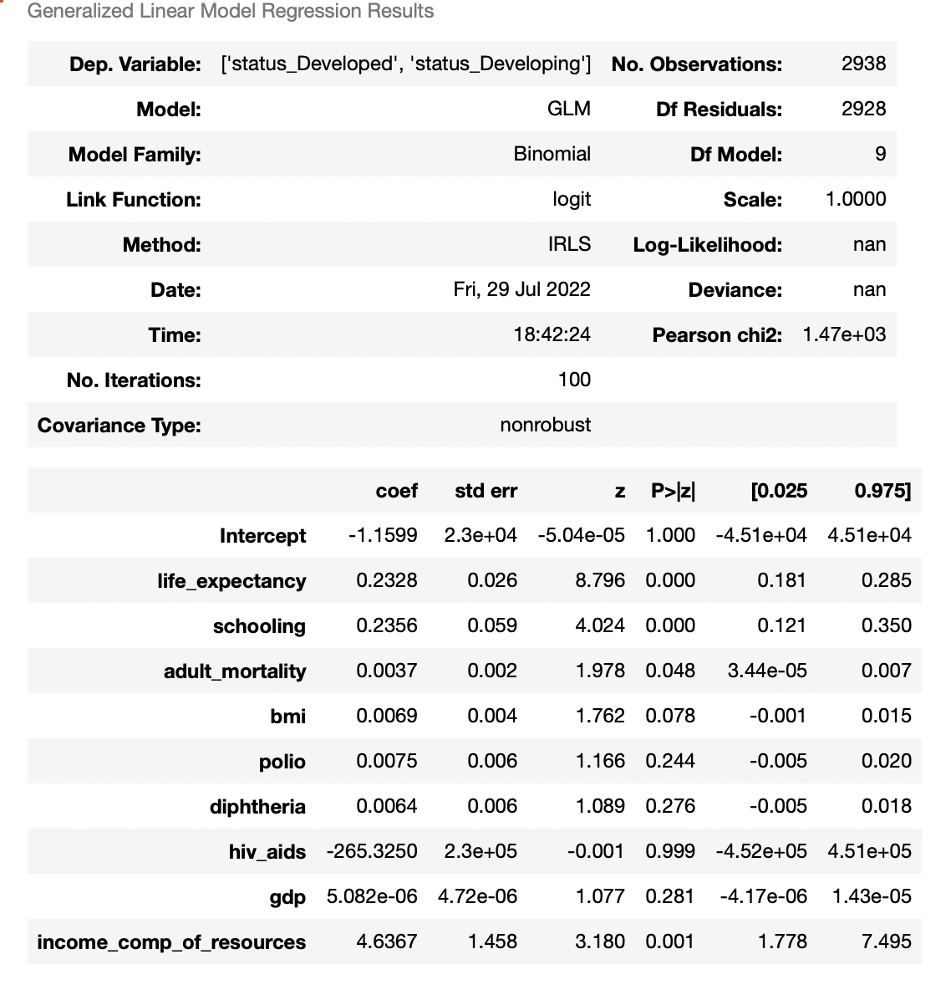
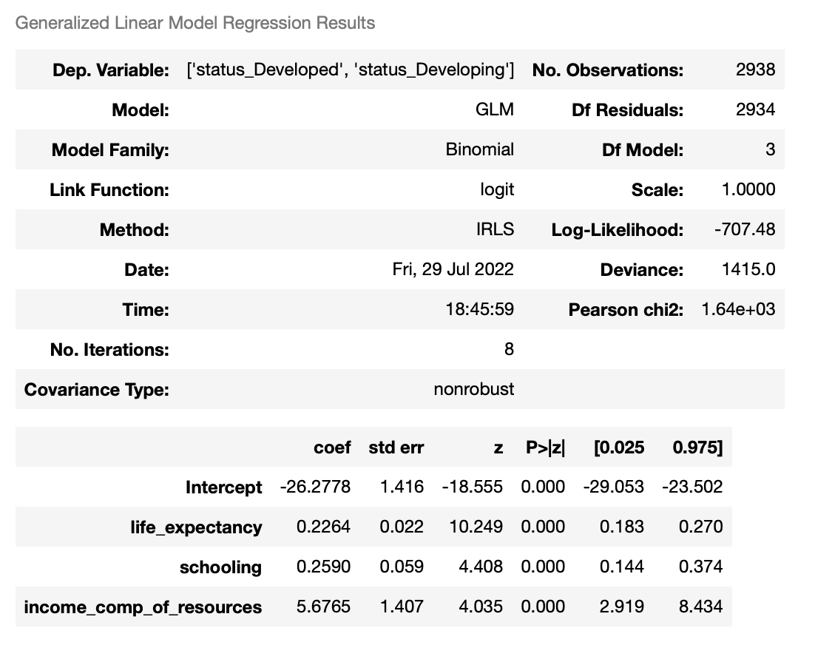
Model 2: Logistic regression (GLM)
Notes:
Results of the summary of the model
What adjustments were done
Accuracy of the final version of the model and what variables gave those results

Slide 9
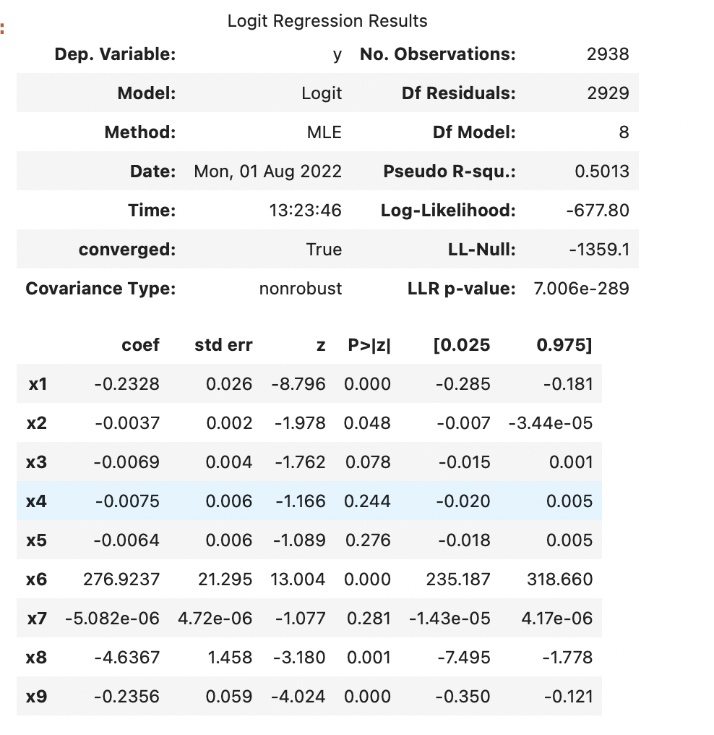
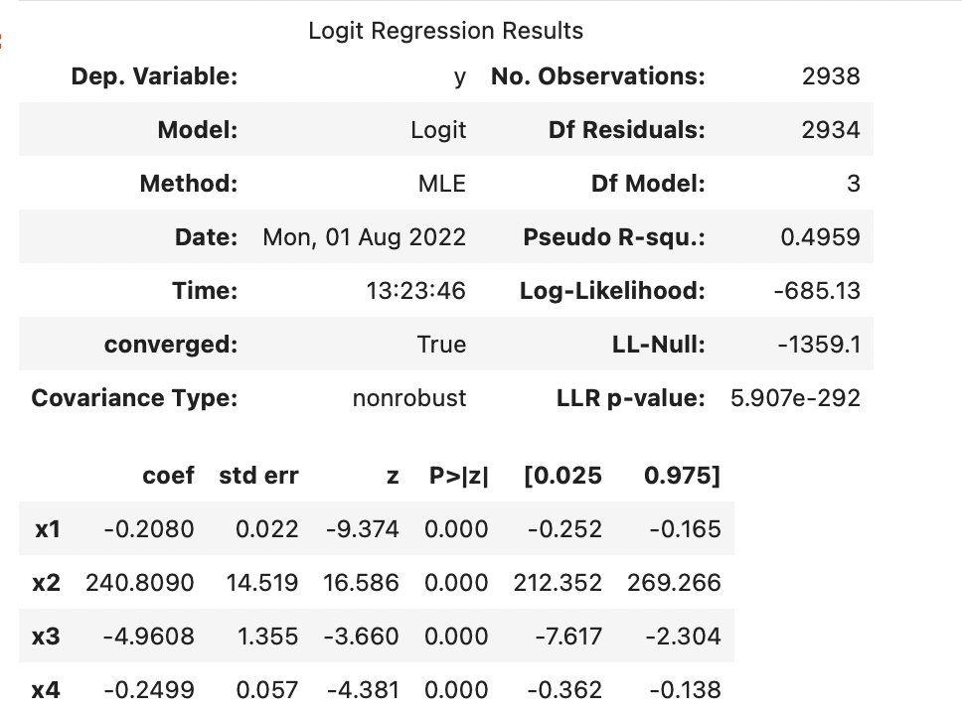
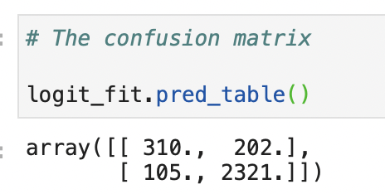
Model 2: Logistic regression (Logit)
True Positive (TP): 310
True Negative (TN): 2321
False Positive (FP): 202
False Negative (FN): 105
Notes:
Results of the summary of the model
What adjustments were done
Accuracy of the final version of the model and what variables gave those results

Slide 10

Conclusion
Life Expectancy is significantly higher developed in developing countries
GDP is significantly higher in Developed countries
Adult mortality in is twice lower in developing vs. developed countries
BMI in Developed countries is higher
AIDS is significantly higher in Developing countries
Schooling is higher in Developed countries
Risk assessment for insurance providers, Marketing
Impact and influence on decision making process in the health care

